Slide 1
IBM Coursera Project
The Battle of Neighbourhoods
By Zakharova Irina

Slide 2
Introduction
The City of New York, is the most populous city in the United States. It is diverse and is the financial capital of USA. It is multicultural. It provides lot of business oppourtunities and business friendly environment. It has attracted many different players into the market. It is a global hub of business and commerce. With it's diverse culture, comes diverse food items. There are many resturants in New York City, each belonging to different categories like Russian, Jewish, Chinese, Indian, French etc.
The market of NYC is highly competitive. As it is highly developed city so cost of doing business is also one of the highest. Thus, any new business venture or expansion needs to be analysed carefully. The insights derived from analysis will give good understanding of the business environment which help in strategically targeting the market. This will help in reduction of risk. And the Return on Investment will be reasonable. This would interest anyone who wants to start a new restaurant busyness in New York city

Slide 3
Problem
The best location in New York City for Caribbean Cuisine.
The areas with high potential Caribbean Restaurant Market.
The areas with lack of Caribbean Restaurants.
The best place to stay if you prefer Caribbean Cuisine.

Slide 4
Data
For this project the next Data were used:
New York City data that contains list Boroughs, Neighbourhoods along with their latitude and longitude. This data were set to explore various neighbourhoods of New York City Data source : https://cocl.us/new_york_dataset
GeoSpace data By using geo space data the New York Borough boundaries were fetched. Data source : https://data.cityofnewyork.us/City-Government/BoroughBoundaries/tqmj-j8zm
Caribbean restaurants in each neighbourhood of NYC By using this Foursquare API all the venues in each neighbourhood ere fetched. Data source : https://api.foursquare.com/v2/venues/explore

Slide 5
Methodology
Collect the New York city data from https://cocl.us/new_york_dataset
Find all venues for each neighborhood using FourSquare API
Filter out all Caribbean Restaurant venues
Find the Ratings, Tips, and Like count for all the Caribbean Resturants by FourSquare API
Next we will sort the data keeping Ratings as the constraint
Visualize the Ranking of neighborhoods using python's Folium library
Visualize boroughs according to average Rating.

Slide 6
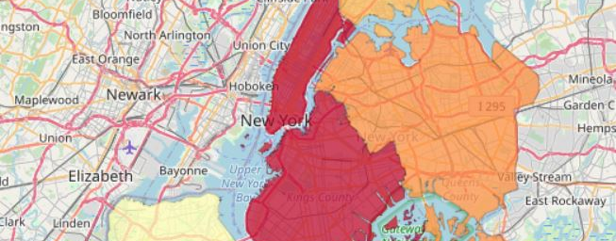
Visualizing boroughs by average rating

Slide 7
Conclusion
Prospect Heights(Brooklyn), Stuyvesant Town(Manhattan), are the best neighborhoods for Caribbean cuisine.
Manhattan have potential Caribbean Resturant Market.
Staten Island ranks last in average rating of Caribbean Restaurant.
Manhattan is the best place to stay if you prefer Caribbean Cuisine.

